Slide 1
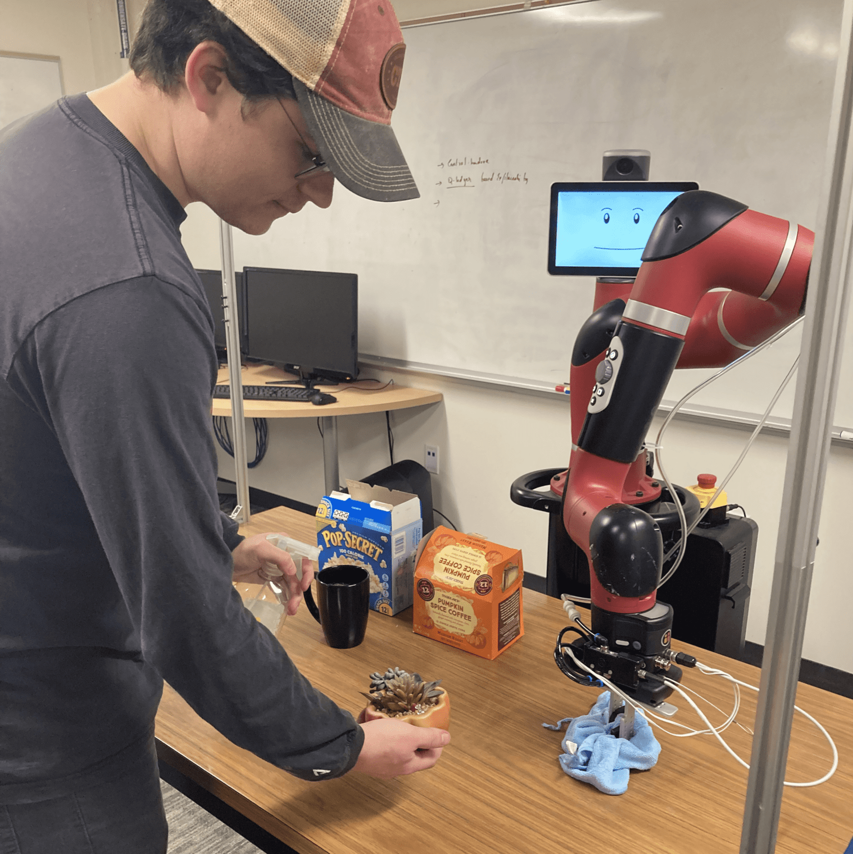
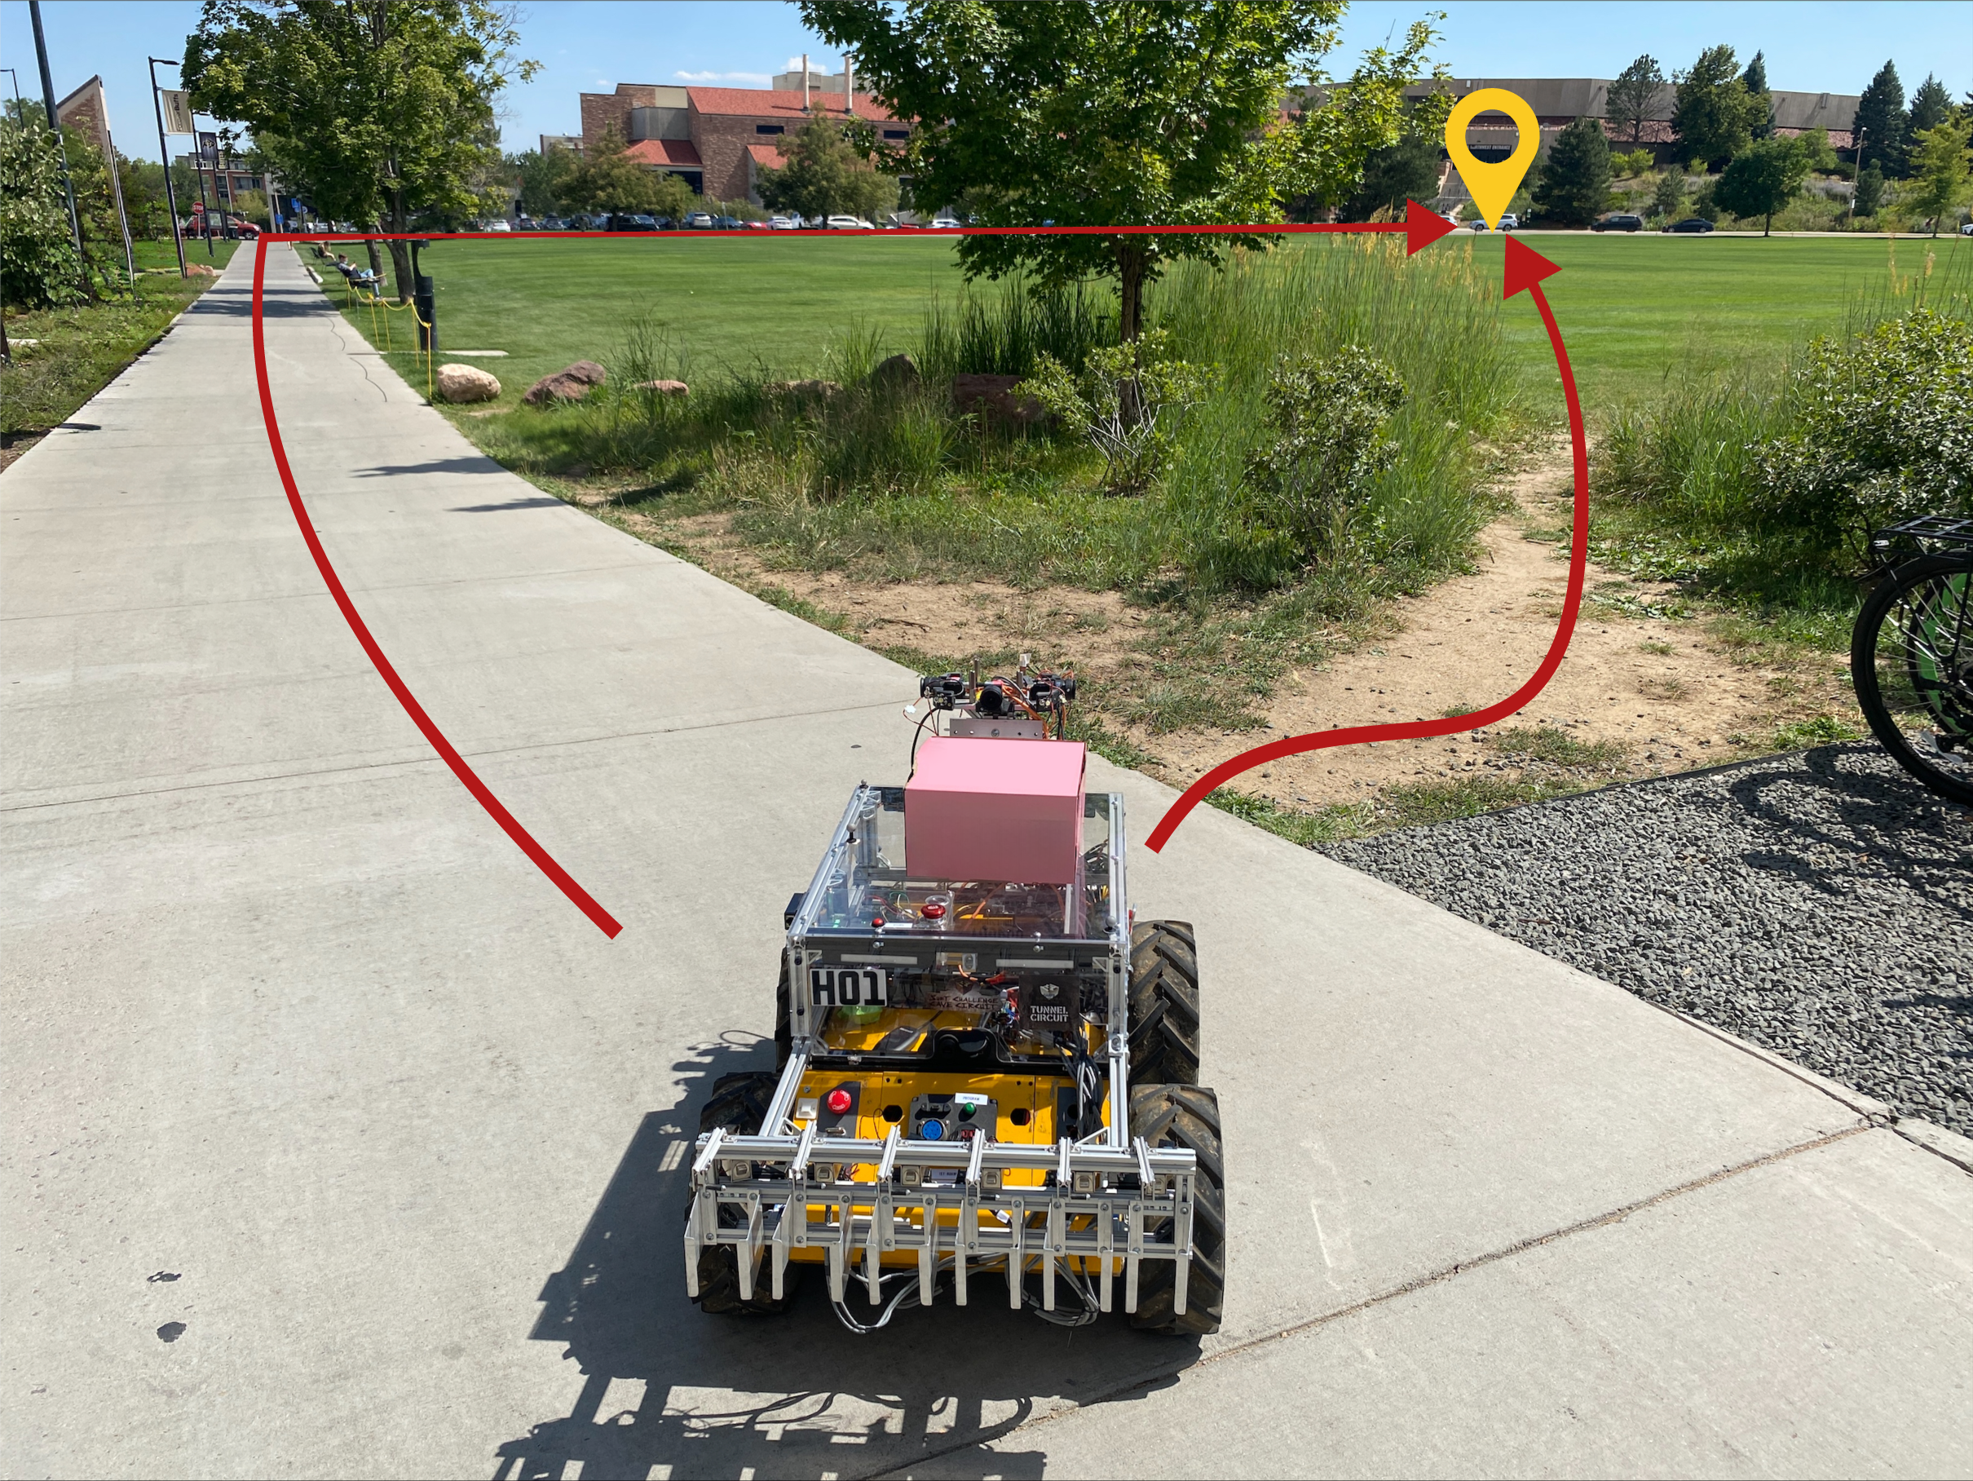
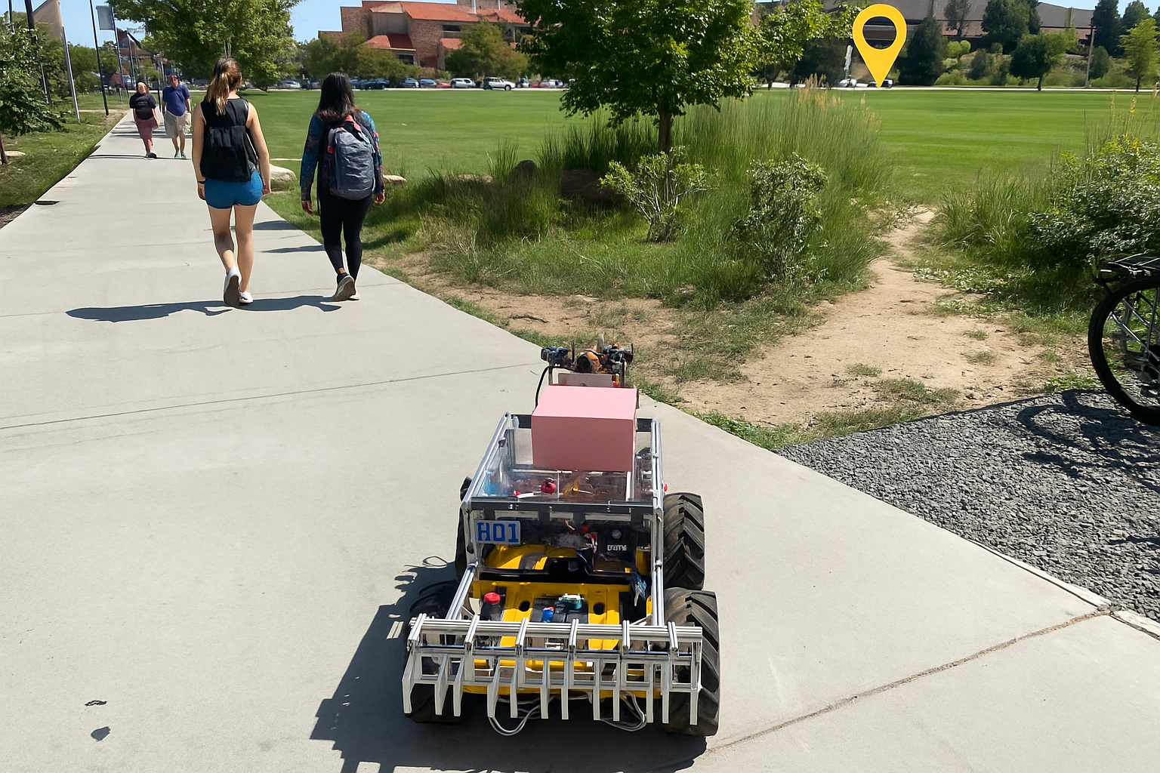
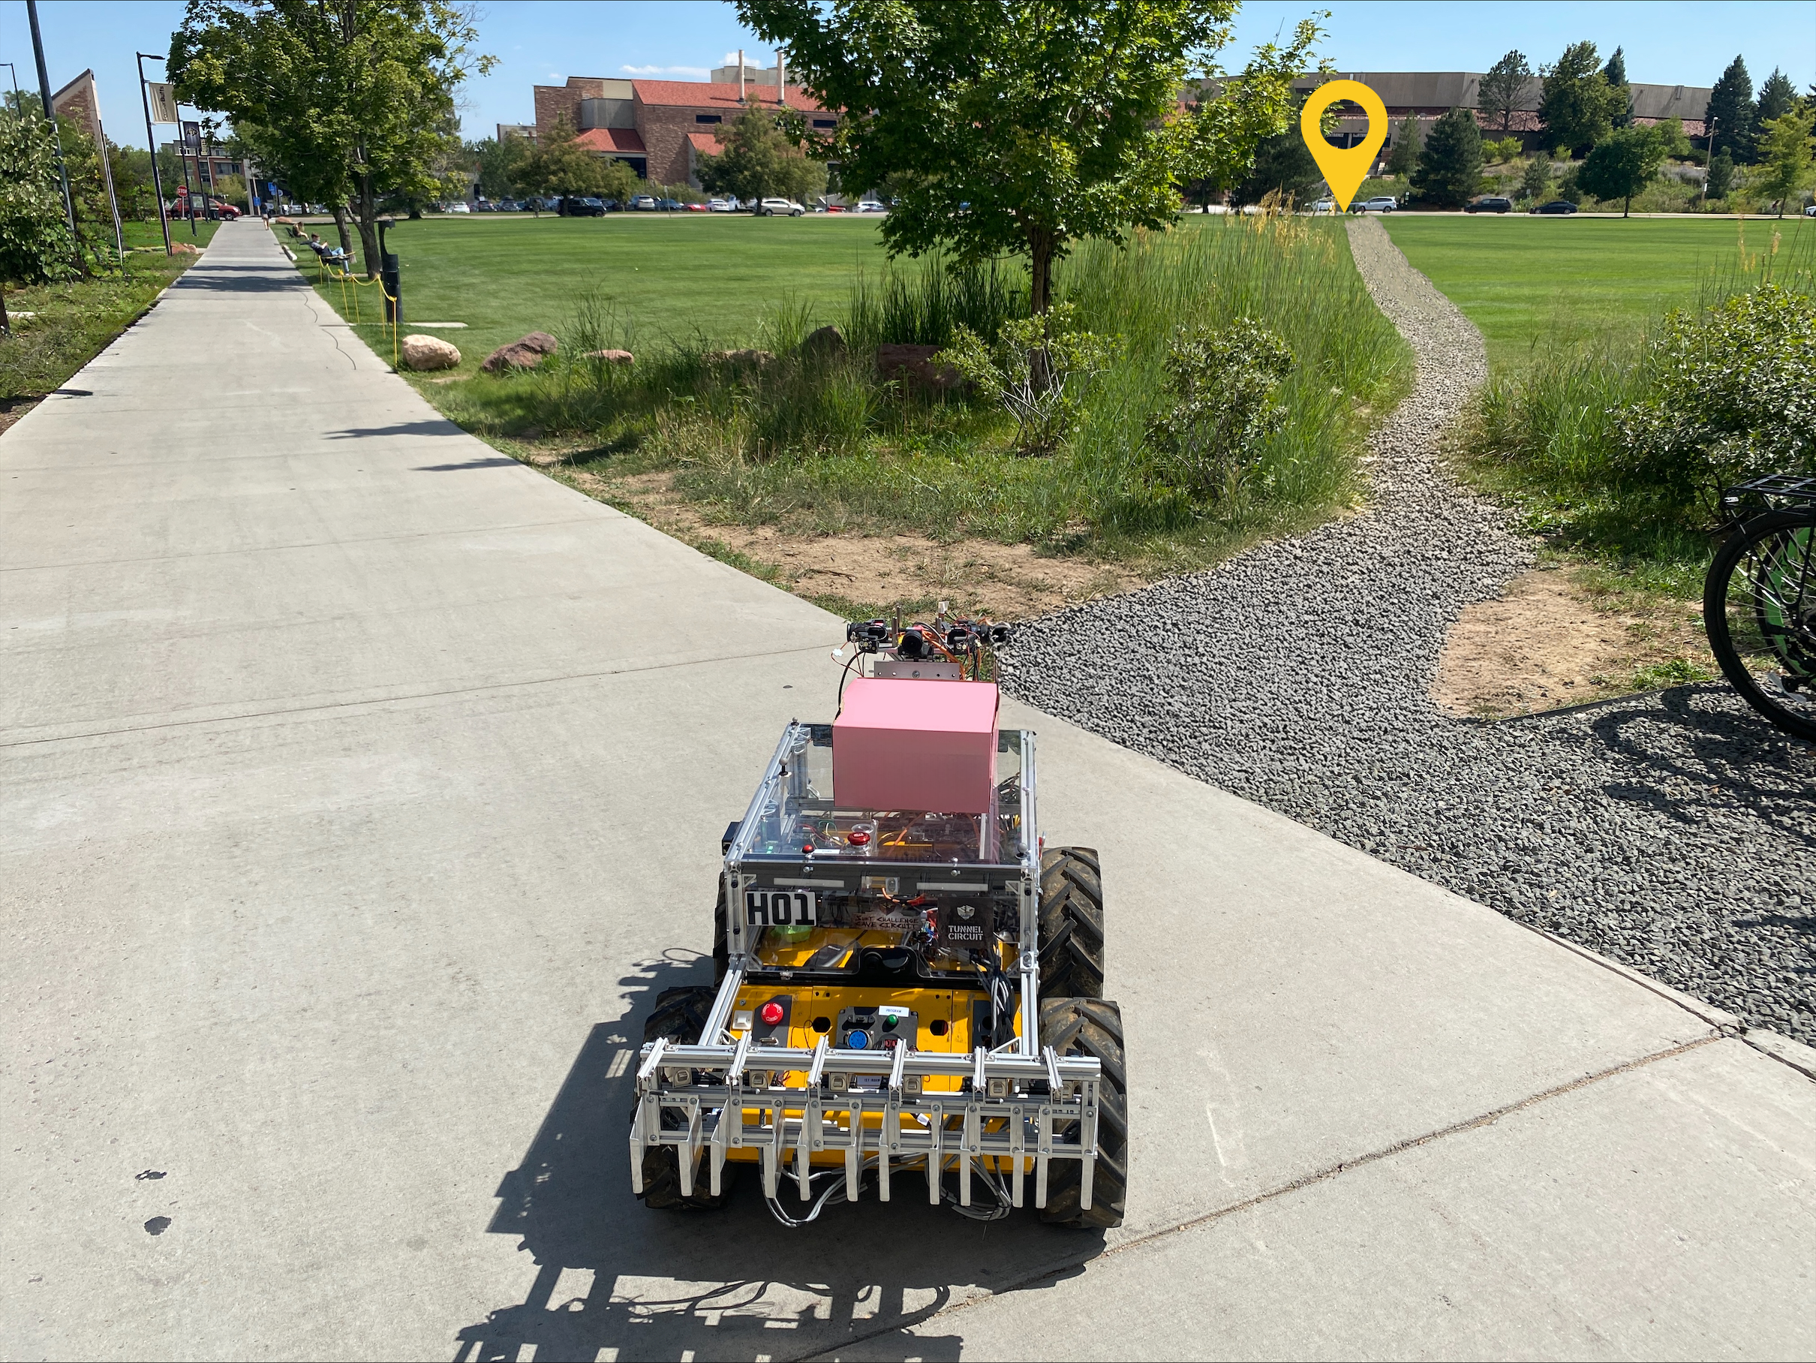
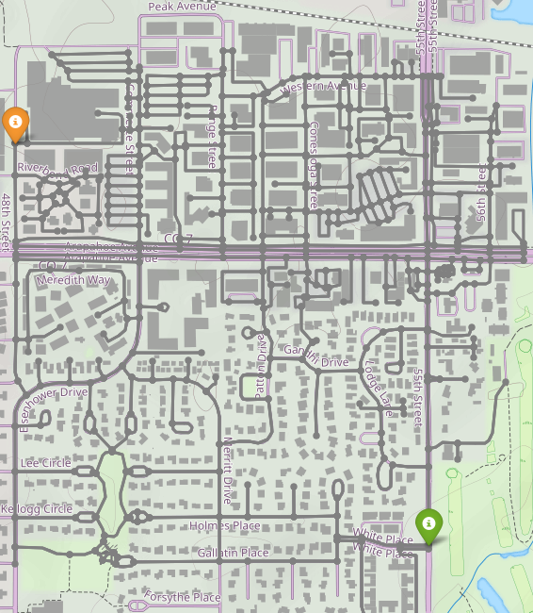
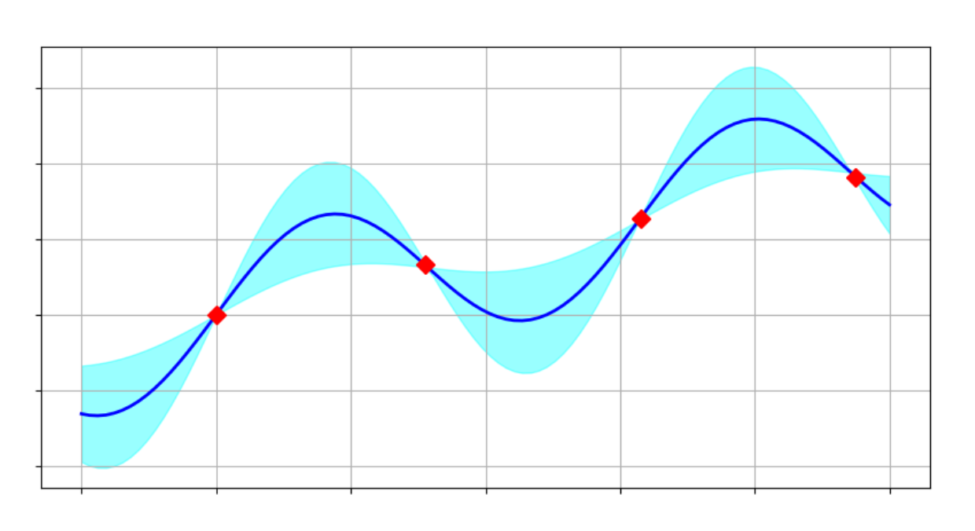
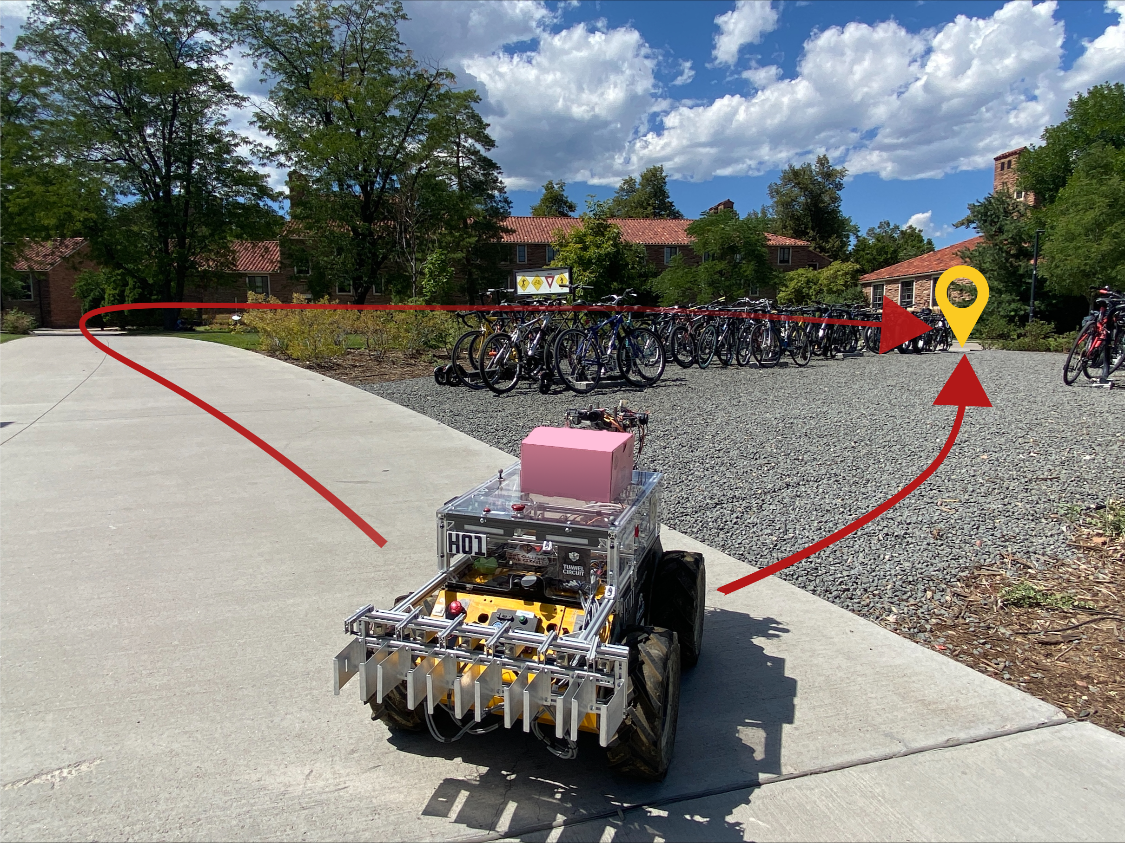
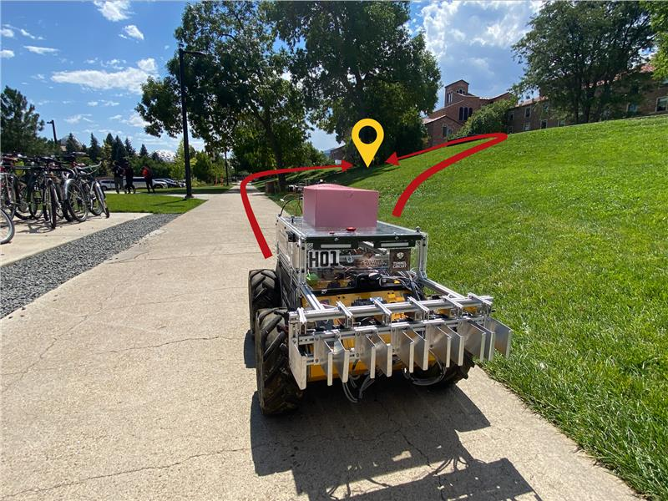
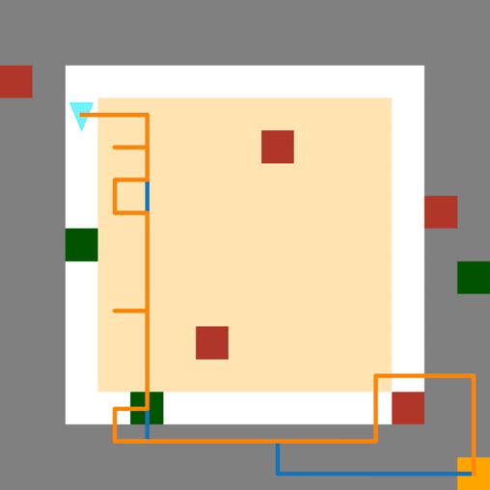
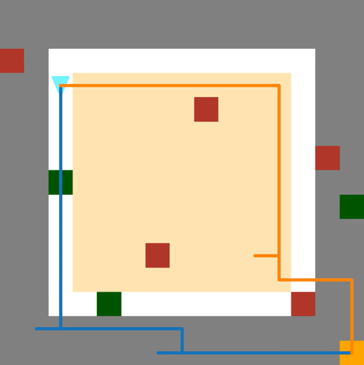
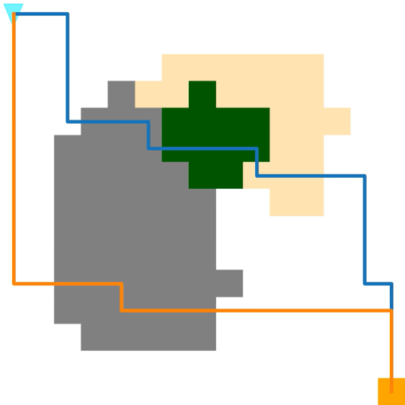
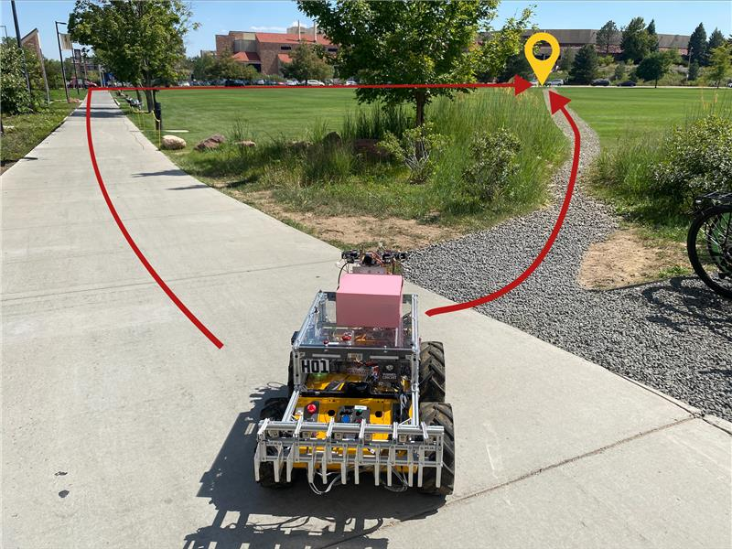
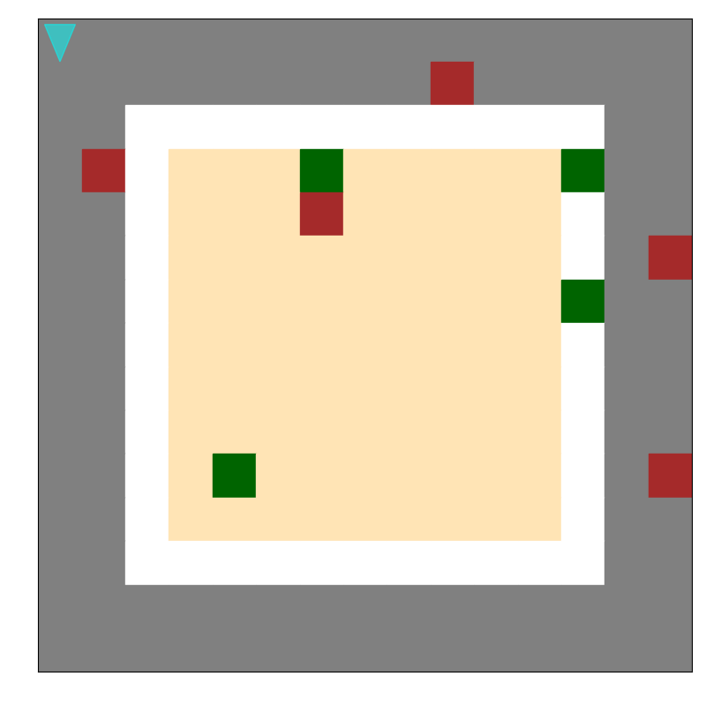
CRED: Counterfactual Reasoning and Environment Design for Active Preference Learning
Yi-Shiuan Tung, Bradley Hayes, Alessandro Roncone
University of Colorado Boulder
Motivation
Background: Preference Learning
Proposed Approach
Experiments
1. Environment Design
2. Street map navigation
$$A$$
$$B$$
When we deploy robots, robots must adhere to different human preferences, from assisting with assembly tasks to cleaning homes.
Features – distance, time, elevation (+/-)
We use the Bradley-Terry Model [1] of human preferences.
Information Gain
Results
Bayesian Optimization
$$p\left(A>B\right)= \frac{exp⁡(R\left(A\right))}{\exp\left(R\left(A\right)\right)+exp⁡(R\left(B\right))}$$
Environment Parameters
Introduction
2. Counterfactual Reasoning
We maintain a Bayesian belief of the humans’ reward function by using Monte Carlo Markov Chain (MCMC).
Information Gain Objective: Find trajectory pair to query human to minimize entropy of belief over reward function [2].
$$\max_{A, B} H\left(w\right)−E[H\left(w | I\right)]$$
$H\left(w\right)−$entropy of our belief $w$
$I −$ human’s input
To make optimization tractable,
Optimize over pre-generated set of trajectories from random rollouts [2]
Rollouts from replay buffer [3]
Belief Distribution of $w$
$$p(w)$$
CRED converges faster with higher accuracy.
$$w_{A}$$
$$w$$
$$w_{B}$$
For a delivery robot, the optimal route depends on travel time, distance, terrain type, and energy efficiency.
$$A$$
$$B$$
Mean Belief Policy[4]
Counterfactual Reasoning
CRED
Extra $1 to save 5 minutes?
Counterfactual reasoning generates queries that better resemble different preferences.
References
Preferences can be hard to specify!
Learn human’s reward by asking humans which trajectories they prefer. We model a linear reward function:
$$R\left(s, a, s′\right)=w^{T}φ\left(s, a, s^{′}\right)$$
$φ\left(s, a, s′\right)−$feature function of transition from state s to s’ by taking action a
Experiments
[1] Agresti, Alan. Categorical data analysis. Vol. 792. John Wiley & Sons, 2012.
[2] Erdem, B., et al. "Asking Easy Questions: A User-Friendly Approach to Active Reward Learning." Conference on Robot Learning. PMLR, 2020.
[3] Lee, Kimin et al. "PEBBLE: Feedback-Efficient Interactive Reinforcement Learning via Relabeling Experience
and Unsupervised Pre-training” ICML , 2021.
[4] Christiano, Paul F., et al. "Deep reinforcement learning from human preferences." Advances in neural information processing systems 30 (2017).
Challenges
1. Grid world navigation
Optimizing over fixed set of trajectories is sample inefficient.
Learned rewards may not generalize to novel environments seen at test time.
Features – Red (Brick), Green (Grass), Yellow (Dirt), Grey (Gravel), White (Paved)

